Slide 1
Earned Income Credit
Earned Income Credit
Pub 4491 – Part 7 – Lesson 30 Pub 4012 – Tab I
Notes:
Legislation enacted Dec. 18, 2015 – Protecting Americans from Tax Hikes Act of 2015 (PATH Act).
No credit or refund for an overpayment for a taxable year shall be made to a taxpayer before Feb. 15 if the taxpayer claimed the Earned Income Tax Credit or Additional Child Tax Credit on the return.
Change begins on January 1, 2017 and may affect returns filed early in 2017.
The IRS will hold the refunds on EITC and ACTC-related returns until
Feb. 15.
This allows additional time to help prevent revenue lost due to identity theft and refund fraud related to fabricated wages and withholding.
The IRS will hold the entire refund until Feb. 15.
Taxpayers should file as they normally do, and tax return preparers should also submit returns as they normally do.

Slide 2
New Legislation for Tax Year 2016
Legislation enacted Dec. 18, 2015 – Protecting Americans from Tax Hikes Act of 2015 (PATH Act).
  No credit or refund for an overpayment for a taxable year shall be made to a taxpayer before Feb. 15 if the taxpayer claimed the Earned Income Tax Credit or Additional Child Tax Credit on the return.
  Change begins on January 1, 2017 and may affect returns filed early in 2017.

Slide 3
New Legislation for TY 2016 (cont)
The IRS will hold the refunds with EITC until Feb. 15.
  Allows additional time to help prevent revenue lost due to identity theft and refund fraud related to fabricated wages and withholding
  Entire refund held until Feb 15
  Taxpayers should file as they normally do, and tax return preparers should also submit returns as they normally do.

Slide 4

Refundable Credit
A refundable credit can generate a refund even if the taxpayer didn’t pay any money in
Notes:
Even if there is no tax liability (i.e. the taxpayer owes no money), the taxpayer can still receive a check from the IRS.

Slide 5
EIC Created in 1976
As part of welfare reform
To keep the working poor off welfare

Slide 6
To Qualify
Must be working
Must be “poor”
Notes:
Have earned income-
Pub 4491 – note 30-3: Self-employment is considered earned income
Income received for work while an inmate in a penal institution must be entered as OTHER INCOME on Form 1040, line 21
AARP Tax-Aide does not use Schedule C-EZ; only Schedule C
Total income below certain thresholds

Slide 7
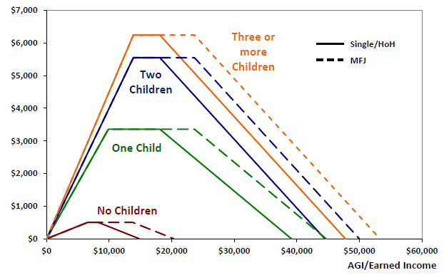
Amount of the Credit
TY 2016

Slide 8
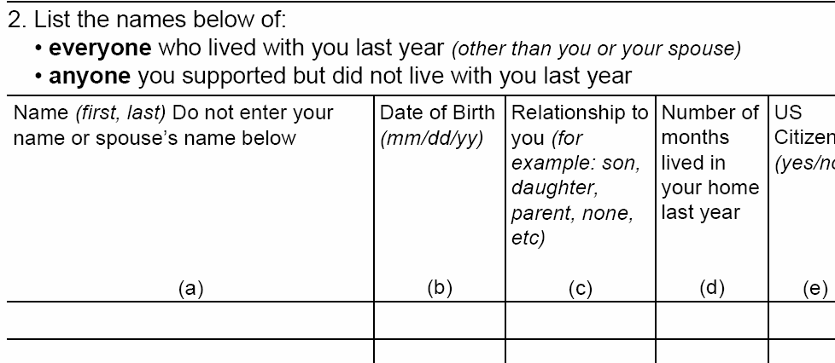
Ask: Who else lived with you last year?
Don’t forget anyone who was temporarily away...
at school? in the hospital? in juvenile detention?
Notes:
Be sure you find out about ANY family members who lived with them
Avoid questions which require YES/NO answers. Asking who else lived with the taxpayer last year assumes that there will be an answer other than YES or NO.

Slide 9

Two Sets of Rules
If taxpayer has qualifying children (QC)
If taxpayer doesn’t have qualifying children
And...
Taxpayer must have earned income

Slide 10
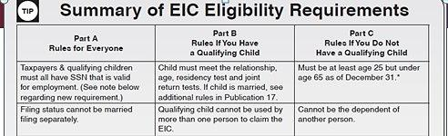
Resource Guide Tab I
Open to Tab I-2

Slide 11
Rules for Everyone
Taxpayer(s) and Qualified Child must have SSNs—not ITINs*See tip from 4491 pg. 3-2 below
Taxpayer cannot file MFS
Must be US citizen or resident alien all year
Cannot exclude foreign earned income – Form 2555
Taxpayer’s maximum investment income = $3,400
Taxpayer cannot be a Qualified Child of another taxpayer
Notes:
TP = taxpayer QC = qualifying child
SSNs must be good for employment.
Maximum investment amount is adjusted for inflation each year.
2016 added Tip in 4491- pg. 30-2: Taxpayers cannot file an amended return retroactively for any year in which they did not have a valid social security number by the due date of the return (including extensions).

Slide 12
Rules if Taxpayer has a QC
Child must meet tests:
  Relationship
  Age
  Residency
  Not filing MFJ
If married, child must be a dependent
Note: Support test does not apply
Notes:
These tests are in Resource Guide Page C-3
Support is not an issue for EIC—This is an exception to the uniform definition of Qualifying Child.

Slide 13
Rules if Taxpayer does not have a QC
Must be at least 25 and under 65 as of December 31
Cannot be dependent of another taxpayer
Must have lived in US more than half the year
Notes:
*Under 65 as of December 31
Taxpayer without a QC cannot be a dependent at all.
Taxpayer with a QC can be a dependent as qualifying relative, not as a qualifying child

Slide 14
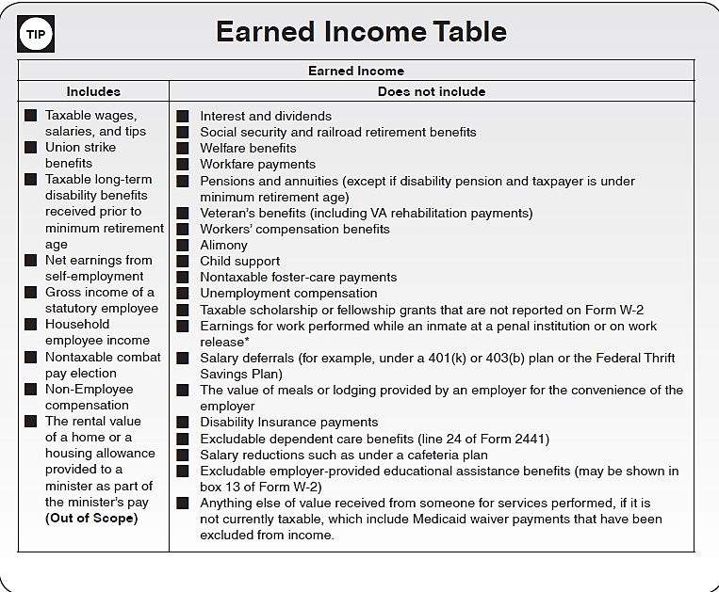
Earned income for EIC*
For CTC and EIC
Open Resource Guide to page I-1
Notes:
Suggested making pen and ink change to 4012 to add “for EIC” to title for TY 2015.
This change does NOT appear in the 2016 version and has been added here.
Note inclusion of long-term taxable disability benefits if under retirement age.
Include combat pay only if including it increases the credit.
Earned Income does not include scholarship income or penal income (or while on work release)
* Pub 4491 Software Hint tab 30-2: Volunteers using software must check the box in the Rollover or Disability section of the Form 1099-R input screen to report disability as wages.

Slide 15
Earned income for EIC*
For CTC and EIC
Open Resource Guide to page I-1
  Pensions and annuities (except if disability pension and taxpayer is under minimum retirements age)
  Taxable long-term disability benefits received prior to minimum retirement age
  Nontaxable combat pay election
  Taxable scholarship or fellowship grants that are not reported on Form W-2
  Earning for work performed while an inmate at a penal institution or on work release
Notes:
Suggested making pen and ink change to 4012 to add “for EIC” to title for TY 2015.
This change does NOT appear in the 2016 version and has been added here.
Note inclusion of long-term taxable disability benefits if under retirement age.
Include combat pay only if including it increases the credit.
Earned Income does not include scholarship income or penal income (or while on work release)
* Pub 4491 Software Hint tab 30-2: Volunteers using software must check the box in the Rollover or Disability section of the Form 1099-R input screen to report disability as wages.

Slide 16
Maximum Income Limits
Number of Children | Other Filing Status | MFJ
None | $14,820 | $20,430
One | $39,296 | $44,846
Two | $44,684 | $50,198
Three or more | $47,955 | $53,505
Notes:
Note difference between definition of “poor” for person with no child and one with 3 children
Income does not include income that has been excluded – such as Medicaid Waiver Payments also known as difficulty-of-care payments.

Slide 17
Credit Amount
Calculated based on
  Earned income -OR-
  AGI
Credit is the smaller of the two
Maximum credit for 2016: $6,269

Slide 18
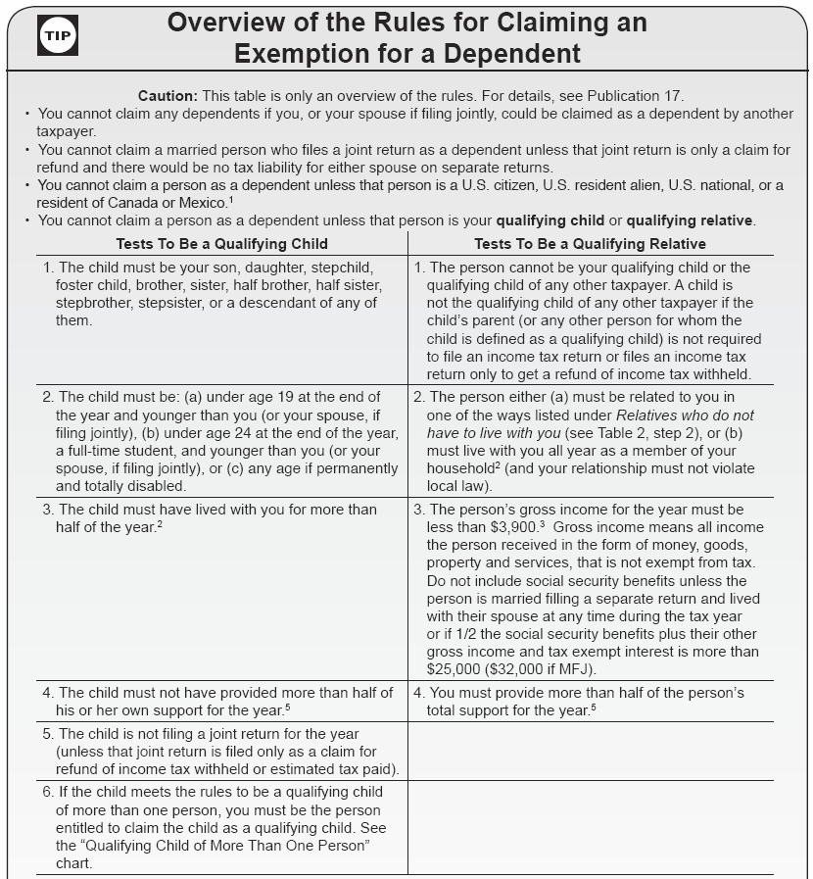
Qualifying Child Review
Resource Guide Page C-3
Relationship
Age
Residency
Not filing MFJ
NOT Support
Notes:
See Pub 17 Chapter 3 for definitions of student and permanently and totally disabled:
“Student” means A full-time student (during some part of each of any 5 calendar months of the year) at a school that has a regular teaching staff, course of study, and a regularly enrolled student body at the school, or at an on-farm training course
“Permanently and totally disabled” means he or she cannot engage in any substantial gainful activity because of a physical or mental condition, and a doctor determines that the condition has lasted or can be expected to last continuously for a least a year or can lead to death.
Residency—except for temporary absences

Slide 19
QC of more than one person
If child is qualifying child for more than one taxpayer, only one can claim the credit
Follow the tie-breaker rules
If taxpayer has QC who is used by someone else, taxpayer can claim EIC with a different child—but cannot claim EIC without a child
Notes:
Tie-breaker rules used to be applied only if two or more people claimed the same child.
Taxpayer Relief Act of 2009 changed that.
Tie-breaker rules now apply all the time—except that either parent (with whom child lived more than ½ the year) can claim the child.

Slide 20
“Tie-breaker” Rules (1 of 2)
If only one is a parent, goes to parent (but see Rule 4)
If both are parents, they can choose, but if both parents claim the same child,
  Goes to parent with whom child lived longest
  If same amount of time, goes to parent with highest AGI
If neither is parent, goes to person with highest AGI
Open to Page C-4
Notes:
These rules used to be optional, but Taxpayer Relief Act of 2009 changed that. These are rules.
They are on page C-4 and on the revised (2015) tri-fold.

Slide 21
“Tie-breaker” Rules (2 of 2)
If one or more parent could claim child but no parent does,
  The child is treated as the qualifying child of the person who had the highest AGI for the year, but only if that persons’ AGI is higher than the highest AGI of any of the child’s parents who can claim the child.
  If parents file MFJ, this rule allows the parents to divide their combined AGI equally (between themselves).
Notes:
If both parents are in the household, add income together and divide by 2
Several good examples in Pub 17, chapter 3.

Slide 22
Child of Divorced...Parents
Must meet the residency requirement, so credit goes to the custodial parent

Slide 23
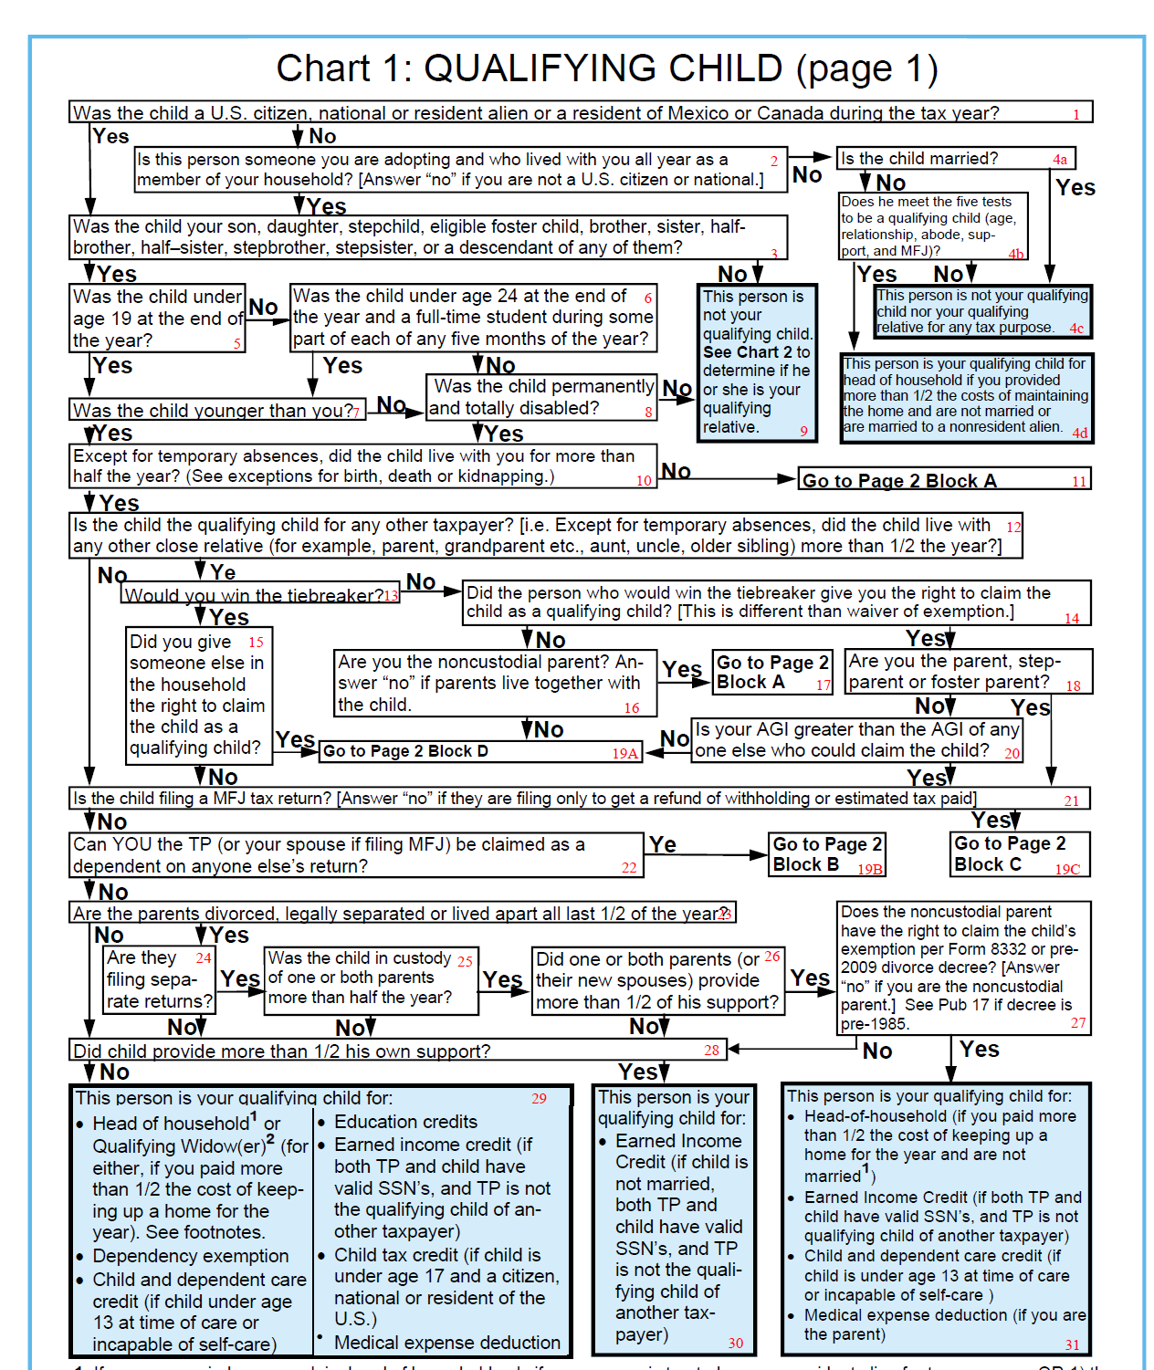
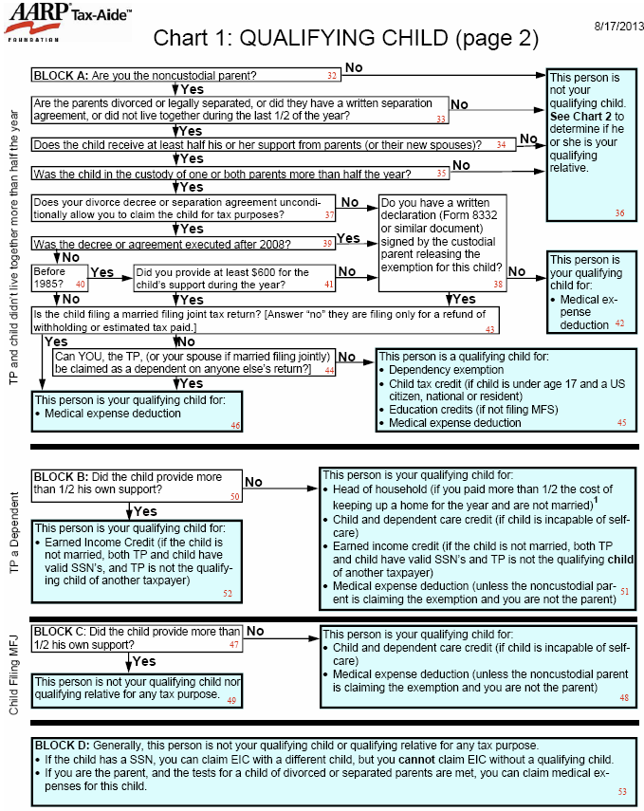
Qualifying Child Chart:
Notes:
Must be a qualifying child—not a qualifying relative.

Slide 24
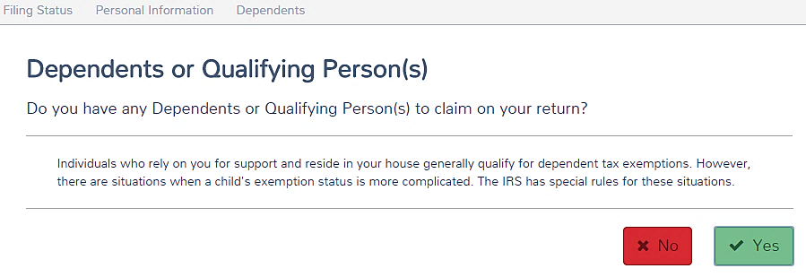
Entering Dependents or Qualifying Persons(s) Information in TaxSlayer
Notes:
Pub 4491 - Tab 30-5
TIP: Taxpayers have the option to choose which taxpayer will claim the child. Tiebreaker rules apply when the child is claimed by multiple taxpayers.
List children from youngest to oldest in the software and …
Conflict between Pub 4491 and TS Manual V4
Pub 4491 says on 30-5 to check the EIC box.
TS Manual says: Check the EIC box on the information page for Form 8862 to be completed for the qualifying child
Checking that box means that the taxpayer won’t get EIC.

Slide 25
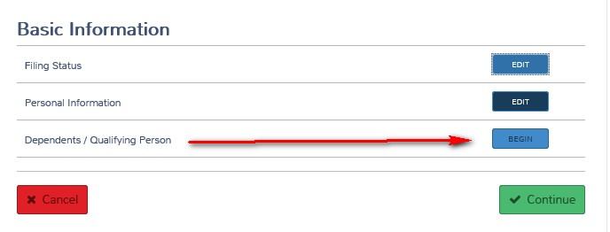
Entering Dependent or Qualifying Persons(s) Information in TaxSlayer continued

Slide 26
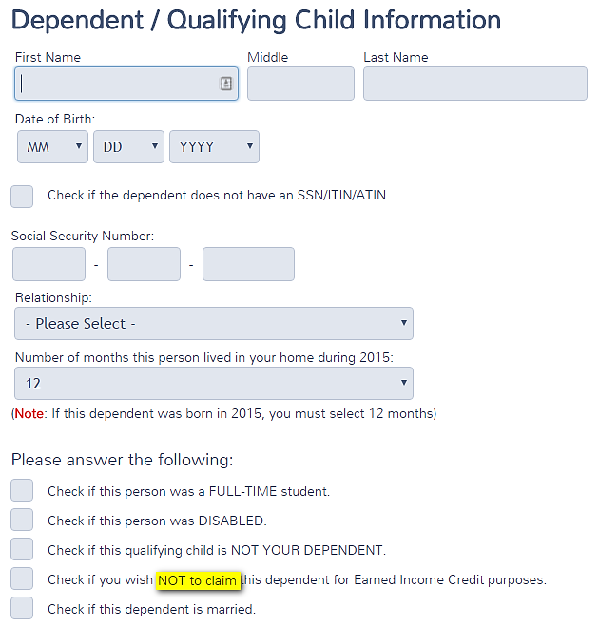
Entering Dependent / Qualifying Child Information in TaxSlayer
Taxpayers and qualifying children must all have SSN that is valid for employment
If the dependent does not have a SSN/ITIN/ATIN?
See next slide
Check if you wish NOT to claim the dependent for EIC Purposes
Notes:
Note the check box is to NOT CLAIM the dependent for EIC purposes.
This conflicts with Pub 4491 Tab 30-5 which says List children from youngest to oldest in the software AND check the EIC box.
Pub 4491 should say check the EIC box if the taxpayer does not qualify for EIC.

Slide 27
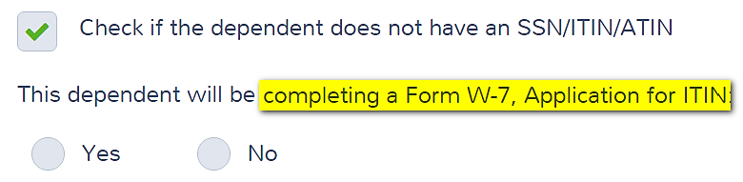
Does Child Have SS# or ITIN?

Slide 28
Entering Dependent / Qualifying Child Information in TaxSlayer continued
Is the birthday correct?
Taxpayers and qualifying children must all have SSN that is valid for employment.
Does the relationship make him
or her a qualifying child?
Did the child live with
the Taxpayer more
than ½ the year?
Notes:
Note the check box is to NOT CLAIM the dependent for EIC purposes.
This conflicts with Pub 4491 Tab 30-5 which says List children from youngest to oldest in the software AND check the EIC box.
Pub 4491 should say check the EIC box if the taxpayer does not qualify for EIC.

Slide 29
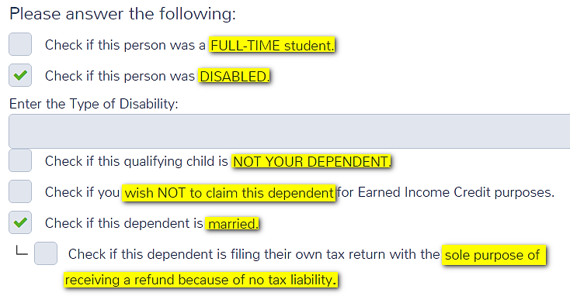
Entering Dependent / Qualifying Child Information in TaxSlayer continued
X
This question is not in Production version.

Slide 30
EIC Eligibility Requirement
Part A – Rules for Everyone
Must have SS# valid for employment
Filing status cannot be MFS
Must be a US citizen or resident alien all year
Cannot file Form 2555 or Form 2555-EZ (relating to foreign earned income)
Investment income must be below $3,400
Cannot be a qualifying child of another person

Slide 31
EIC Eligibility requirements
Part B
Rules If You Have a Qualifying Child
Part C
Rules If You Do Not Have a Qualifying Child
Child must meet the relationship, age, residency test and joint return tests. If child is married, see additional rules in Pub 17
Qualifying child cannot be used by more than one person to claim the EIC
The taxpayer cannot be a qualifying child of another person
Must be at least age 25 but under age 65 as of December 31.
Cannot be the dependent of another person.
Must have lived in the United States more than half the year.
Cannot be a qualifying child of another person.
Notes:
Question 7: Yes if Unmarried
Other questions may turn red as you answer these

Slide 32
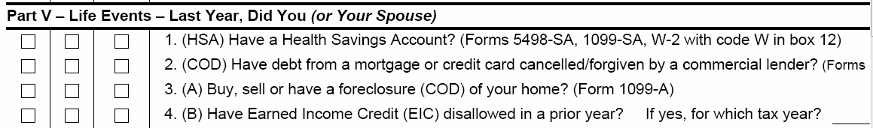
Disallowed EIC in prior year?
Check Intake Sheet
Ask the taxpayer
Answer “no” if disallowed for math error

Slide 33
Notes
If EIC has been denied in the past, Form 8862 needs to be filed
If taxpayer does not qualify for EIC because s/he is the qualifying child of another— or because s/he has a qualifying child being claimed by another—mark the box at the top of Schedule EIC
Reminder: Support is not a test for EIC
Notes:
If EIC denied due to reckless or intentional disregard or EIC rules, taxpayer cannot claim EIC for 2 tax years.
If due to fraud, cannot claim EIC for 10 years.

Slide 34
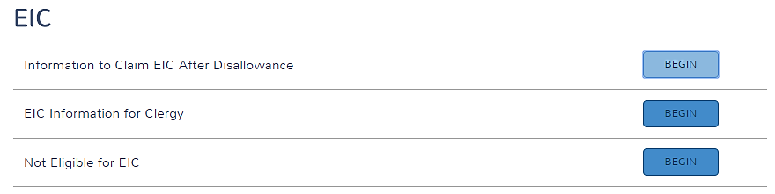
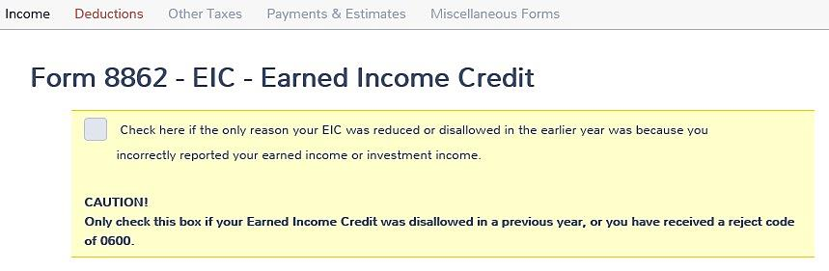
Figuring EIC Tax Credit –
EIC Page - Disallowance
Disallowance

Slide 35
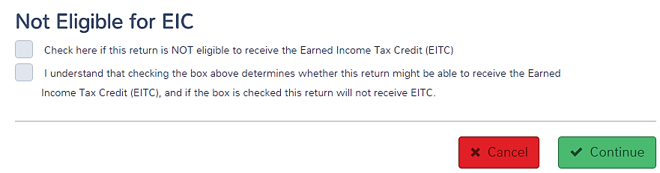
Figuring EIC Tax Credit –
EIC Page – Not Eligible for EIC
Not Eligible?
Requires Taxpayer signature

Slide 36
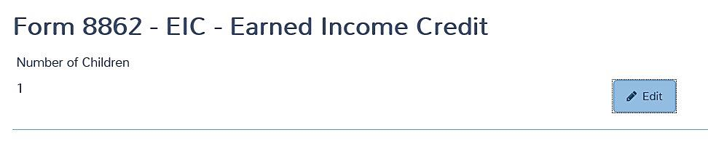
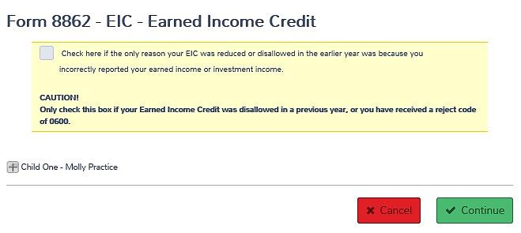
Form 8862 – Dependents and EIC was Disallowed
Enter each child one at a time.
Check if EIC was
Reduced or
disallowed.

Slide 37
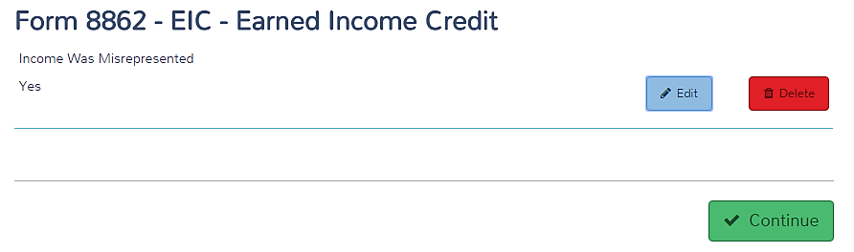
Form 8862 – EIC Summary Page

Slide 38
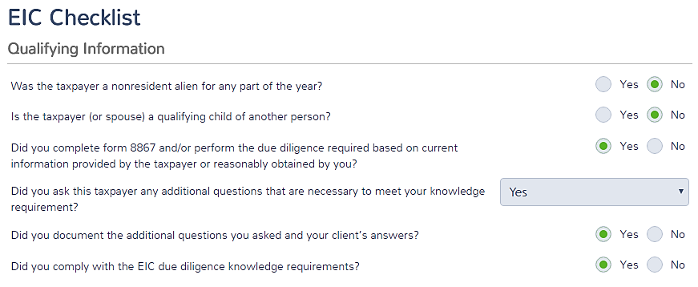
EIC Checklist -
Answer based on situation
Standard answers based on normal Tax-Aide interview process
Notes:
See Pub 4012 Tab I-pages 6-8 for worksheets

Slide 39
Standard Responses versus Situational Responses
Responses meet Tax-Aide Standards
  Have a discussion
  Ask questions
  Use the Intake Sheet to make notes (or Notes in TaxSlayer)
  Don't ignore information presented

Slide 40
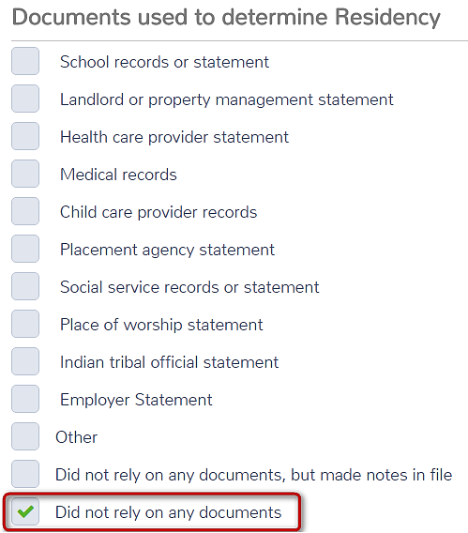
Documents Used to determine Residency
Accept taxpayer’s word on residency unless we have reason not to, and don’t ask for any documents to support it other than the Intake Sheet
Standard answer

Slide 41
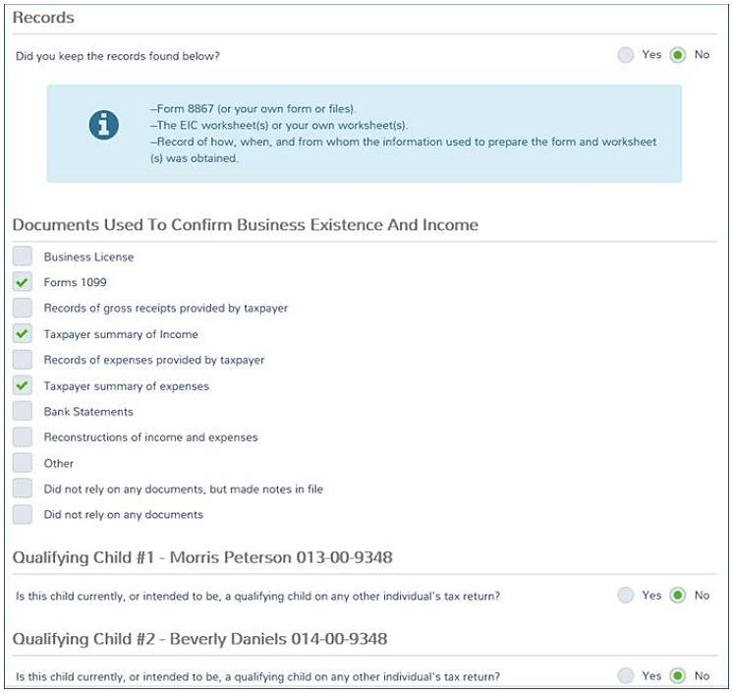
We don’t keep any records.
Taxpayer has Schedule C -
Situational Responses
QC responses are situational

Slide 42
Quality Review
Have all qualifying children been included?
  Those temporarily away?
  Those who are self-supporting?
  Those with “permanent” disabilities?
Has penal income been identified?
Sch EIC and WKt completed correctly?
Notes:
If EIC denied due to reckless or intentional disregard or EIC rules, taxpayer cannot claim EIC for 2 tax years.
If due to fraud, cannot claim EIC for 10 years.

Slide 43
Schedule EIC
TS automatically computes EIC Worksheets and Schedule EIC
Turn to Pub 4012 Tab I

Slide 44

Notes
Remind taxpayers that this credit will disappear when child turns 19 (unless he is a full-time student or disabled)
This will happen this year (2016) for children with birthdates in:
  1997 or
  1992 (for a full-time student)

Slide 45
Quiz 1
Tom is 32 years old. He cannot work and lives with his parents. He receives social security disability checks, which he uses to pay his folks for his room and board and for his clothes and entertainment.
Can his parents claim him as a dependent?
Can they claim him for EIC?
Notes:
Use Qualifying Child charts to find answers about QCs
Not as a dependent: he provides more than half of his support.
Yes for EIC: the support test does not apply.

Slide 46
Quiz 1 Answer
Not as a dependent: He provides more than half of his own support.
Yes for EIC: The support test does not apply.

Slide 47
Quiz 2
John and Mary have ITINS, but their two children have social security cards
Can John and Mary claim the children as dependents?
Can they claim them for EIC?
Notes:
Yes for dependency
No for EIC—must have social security numbers

Slide 48
Quiz 2 Answer
Yes – Meet all requirements for dependency
No – Both taxpayer and QC must have SSNs to qualify for EIC

Slide 49
Quiz 3
Mary has always claimed her daughter Susan as a dependent and for EIC
In November, Susan got married and plans to file MFJ with her husband
Can Mary claim Susan as a dependent?
Can she claim Susan for EIC?
Notes:
No, MFJ disqualifies for dependency
No, if married, child must be a dependent.
NOTE: If class is ready, discuss possibility of Susan and husband filing MFS. Could make a big difference in total refunds for the family.

Slide 50
Quiz 3 Answer
No – MFJ (unless filing only to claim a refund of withholding or estimated tax) disqualifies for dependency
No – If married, child must be a dependent
Notes:
NOTE: If class is ready, discuss possibility of Susan and husband filing MFS. Could make a big difference in total refunds for the family.

Slide 51
Quiz 4
70-year old worker with no children at home has earned income of $10,000
TaxSlayer does not give him any EIC. Is this correct?
Notes:
Yes, without a child, must be between 25 and 65.

Slide 52
Quiz 4 Answer
Yes – Without a child, taxpayer must be at least 25 but under 65 to qualify for EIC

Slide 53
Quiz 5
Bill is 30 years old and earned $33,000; his wife, Emily, is 27 and earned $1,000
Bill and Emily have three children under age 19 who lived with both of them until August when they divorced
The children lived with Emily through the rest of the year
Who is eligible to claim EIC?

Slide 54
Quiz 5 ANSWER
Emily is the one eligible to claim all
  The children lived with her the longest (tiebreaker)
  She could choose to let Bill claim them
Bill could claim some or all of the children if Emily does not claim them (lived with Bill more than ½ the year and AGI is not an issue between parents, except as a tiebreaker)

Slide 55
Earned Income Credit
Questions?
Comments…

